Slide 1
St. Louis Central Corridor West Building Permits
Monthly Report: February 2022

Slide 2
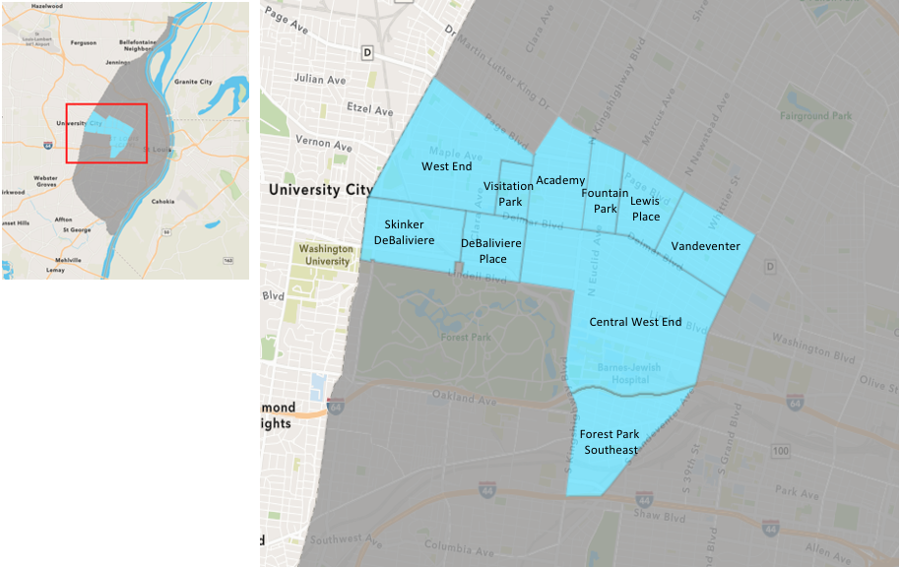
St. Louis Neighborhood Spatial Reference

Slide 3
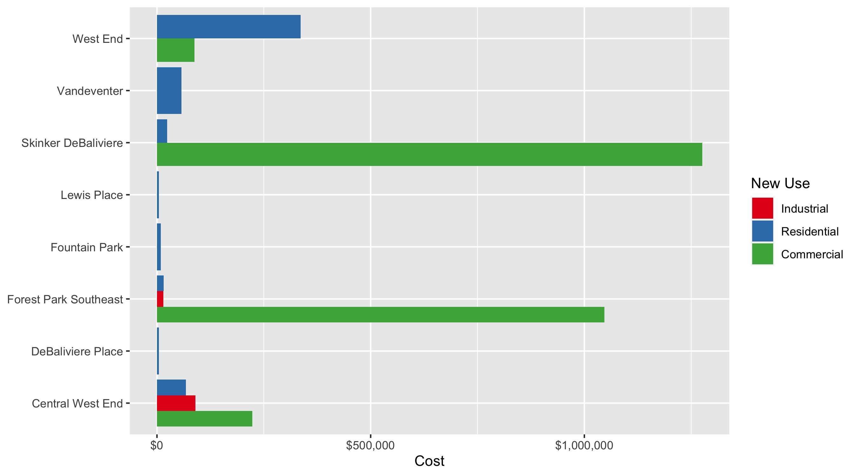
Neighborhood Summary: Average Building Permit Cost

Slide 4
Neighborhood Summary
February 2022 | February 2022 | February 2022 | February 2022
Neighborhood | Average Cost | # of Permits | Total Value of Permits
Academy | $0.00 | 0 | $0
Central West End | $144,801.63 | 19 | $2,751,231
DeBaliviere Place | $4,130.00 | 2 | $8,260
Forest Park Southeast | $273,200.42 | 12 | $3,278,405
Fountain Park | $9,000.00 | 2 | $18,000
Lewis Place | $4,500.00 | 1 | $4,500
Skinker DeBaliviere | $493,087.50 | 8 | $3,944,700
Vandeventer | $57,166.67 | 3 | $171,500
Visitation Park | $0.00 | 0 | $0
West End | $223,015.73 | 33 | $7,359,519
Last 6 Months | Last 6 Months | Last 6 Months | Last 6 Months
Neighborhood | Average Cost | # of Permits | Total Value of Permits
Academy | $45,550.72 | 25 | $1,138,768
Central West End | $482,621.90 | 219 | $105,694,196
DeBaliviere Place | $53,234.04 | 24 | $1,277,617
Forest Park Southeast | $65,234.81 | 94 | $6,132,072
Fountain Park | $34,410.00 | 9 | $309,690
Lewis Place | $98,374.00 | 14 | $1,377,236
Skinker DeBaliviere | $243,757.13 | 46 | $11,212,828
Vandeventer | $98,746.75 | 16 | $1,579,948
Visitation Park | $42,475.00 | 4 | $169,900
West End | $89,303.87 | 107 | $9,555,514

Slide 5
Core Neighborhoods

Slide 6
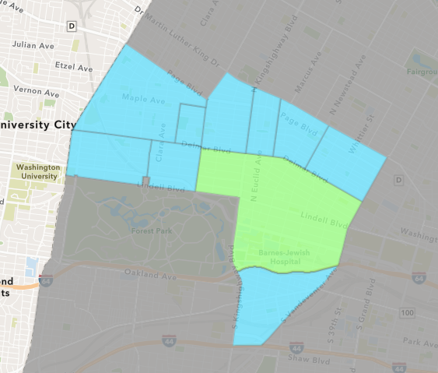
Central West End
February 2022 Neighborhood Cost Breakdown
Mean: $144,802
Median: $60,414
Range: $4,000 - $1,500,000

Slide 7
Central West End: Summary Notes
19 building permits in February 2022
-26.92% change compared to February 2021 (26 total building permits)
$144,802: Average building permit cost in February 2022
59.64% change compared to February 2021 ($90,703)
51 total building permits in 2022
-20.31% change YTD compared to this time in 2021 (64 total building permits)
$918,924: YTD average building permit cost in 2022
1177.10% change YTD compared to this time in 2021 ($71,954)

Slide 8
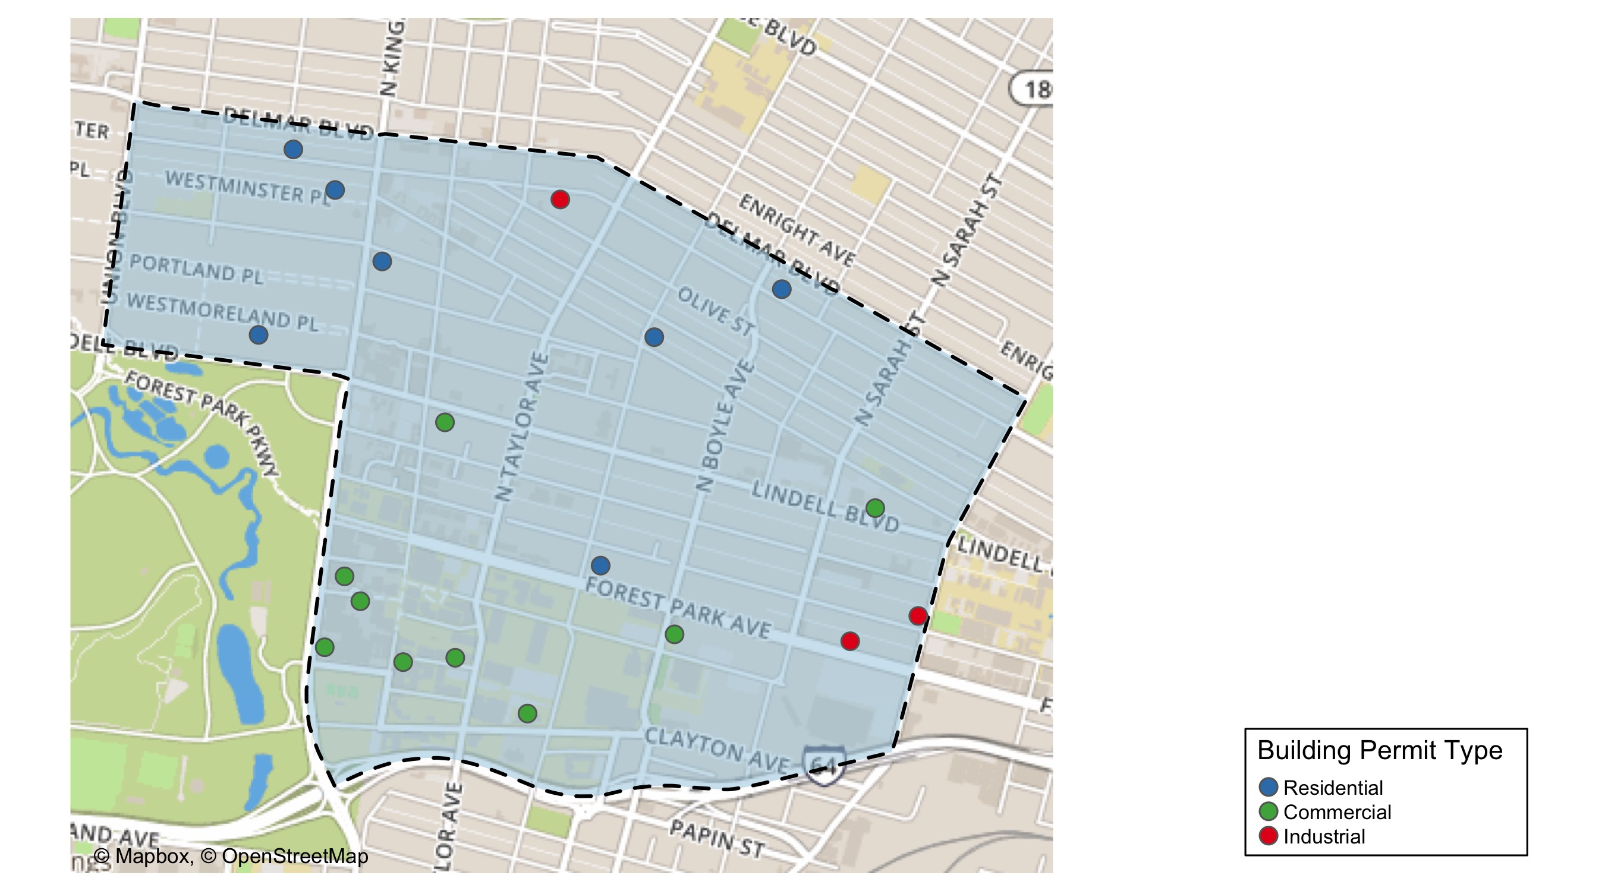
Central West End

Slide 9
Neighborhood Summary
February 2022 | February 2022 | February 2022 | February 2022
Permit Use | Average Cost | # of Permits | Total Value of Permits
Commercial | $222,906.33 | 9 | $2,006,157
Industrial | $90,166.67 | 3 | $270,500
Residential | $67,796.29 | 7 | $474,574
Last 6 Months | Last 6 Months | Last 6 Months | Last 6 Months
Permit Use | Average Cost | # of Permits | Total Value of Permits
Commercial | $1,033,402.69 | 87 | $89,906,034
Industrial | $54,192.86 | 14 | $758,700
Residential | $127,368.32 | 118 | $15,029,462

Slide 10
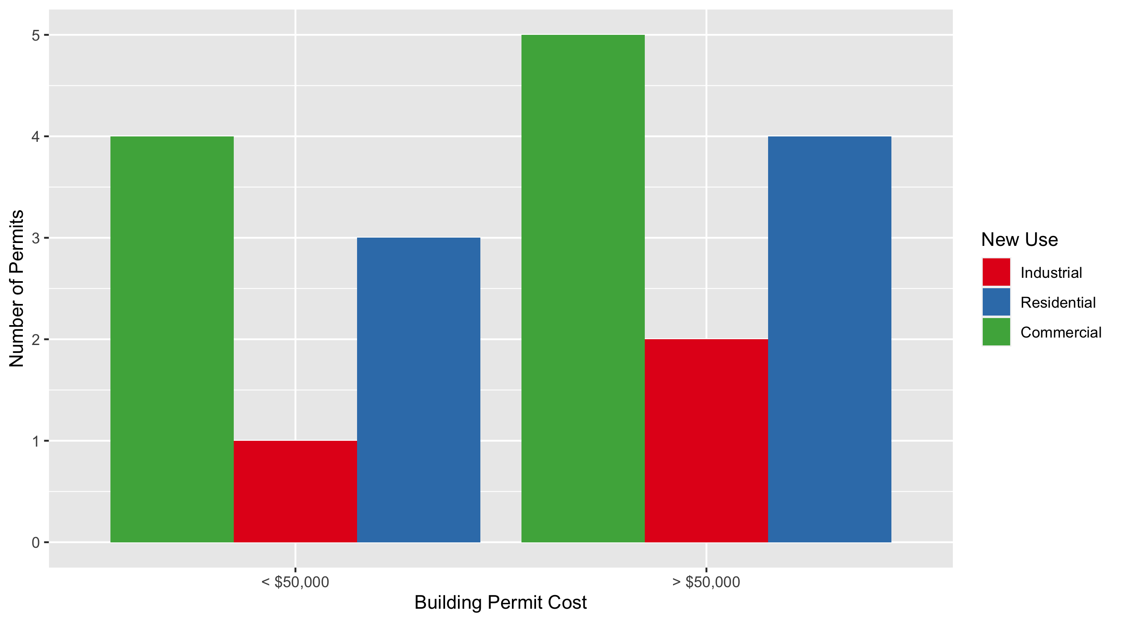
Central West End Permit Cost Breakdown

Slide 11
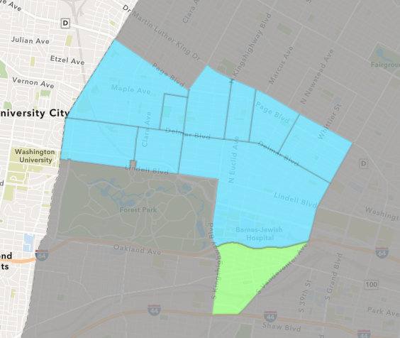
Forest Park Southeast
February 2022 Neighborhood Cost Breakdown
Mean: $273,200
Median: $4,050
Range: $200 - $3,100,000

Slide 12
Forest Park Southeast: Summary Notes
12 building permits in February 2022
-7.69% change compared to February 2021 (13 total building permits)
$273,200: Average building permit cost in February 2022
178.90% change compared to February 2021 ($97,958)
22 total building permits in 2022
4.76% change YTD compared to this time in 2021 (21 total building permits)
$152,377: YTD average building permit cost in 2022
68.31% change YTD compared to this time in 2021 ($90,531)

Slide 13
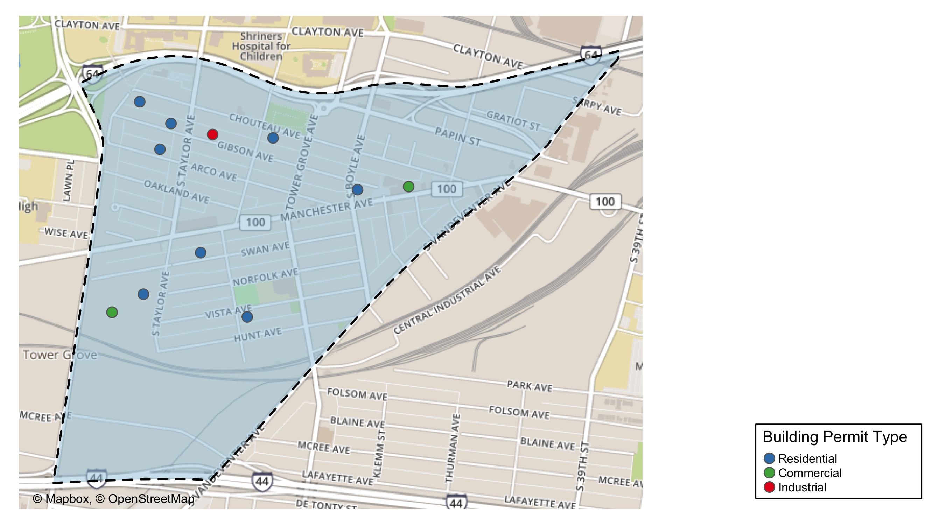
Forest Park Southeast

Slide 14
Neighborhood Summary
February 2022 | February 2022 | February 2022 | February 2022
Permit Use | Average Cost | # of Permits | Total Value of Permits
Commercial | $1,046,989.7 | 3 | $3,140,969
Industrial | $15,000.0 | 1 | $15,000
Residential | $15,304.5 | 8 | $122,436
Last 6 Months | Last 6 Months | Last 6 Months | Last 6 Months
Permit Use | Average Cost | # of Permits | Total Value of Permits
Commercial | $199,900.06 | 18 | $3,598,201
Industrial | $12,233.33 | 6 | $73,400
Residential | $35,149.59 | 70 | $2,460,471

Slide 15
Forest Park Southeast Individual Permit Breakdown
Neighborhood | Owner | New Use | Cost | address
Forest Park Southeast | BROWN, TAWANA | Residential | $3,000 | 4232 GIBSON AV
Forest Park Southeast | HAGENE, ANDREW | Residential | $3,100 | 4558 CHOUTEAU AV
Forest Park Southeast | SWAN 2020 LLC | Residential | $2,000 | 4427 SWAN AV
Forest Park Southeast | GROVE LOFTS STL LLC | Commercial | $2,200 | 4145 MANCHESTER AV
Forest Park Southeast | REILLY, MARY | Industrial | $15,000 | 4451 GIBSON AV
Forest Park Southeast | FRAILEY, SCOTT M & GANNA SHEYKO | Residential | $5,000 | 4529 ARCO AV
Forest Park Southeast | WASHINGTON UNIVERSITY | Commercial | $3,100,000 | 1234 S KINGSHIGHWAY BLVD
Forest Park Southeast | GRADZIK, AGNIESZKA | Residential | $200 | 4398 CHOUTEAU AV
Forest Park Southeast | SWAN APARTMENTS LLC | Residential | $102,936 | 4500-40 SWAN AV
Forest Park Southeast | WASHINGTON UNIVERSITY | Commercial | $38,769 | 1234 S KINGSHIGHWAY BLVD
Forest Park Southeast | GELVEN PROPERTIES LLC | Residential | $5,000 | 4521 GIBSON AV
Forest Park Southeast | TOUMAYAN, GREGORY | Residential | $1,200 | 4364 VISTA AV

Slide 16
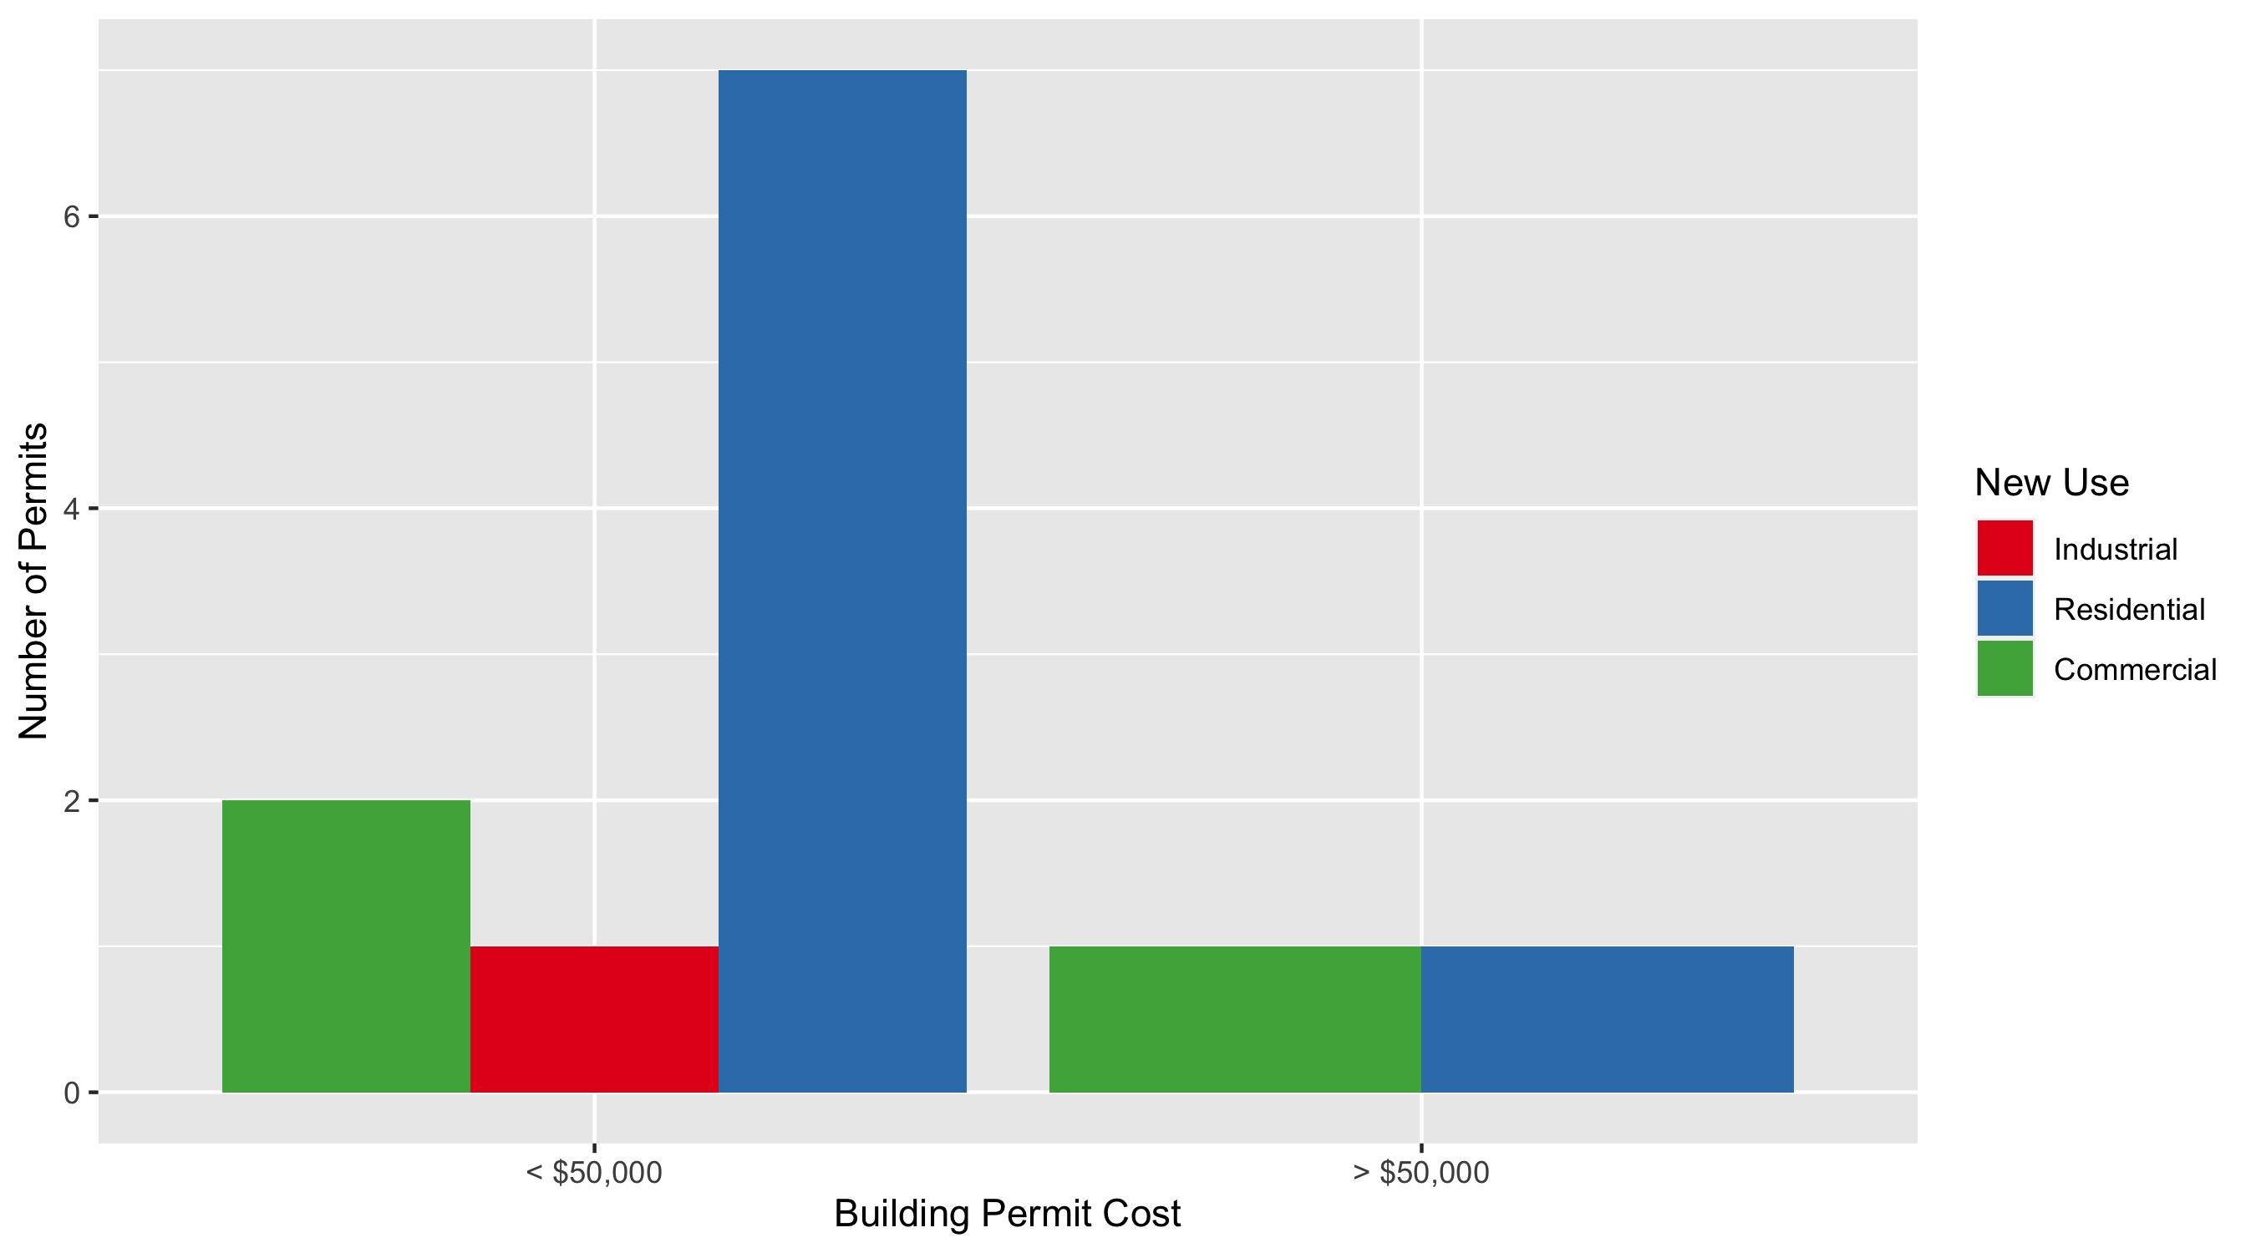
Forest Park Southeast Permit Cost Breakdown

Slide 17
Expanded Service Area

Slide 18
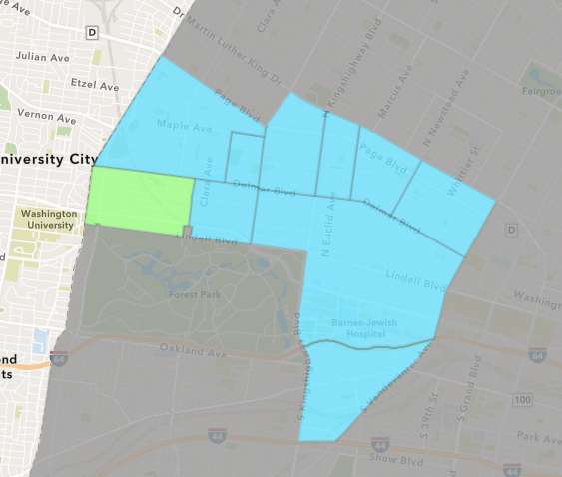
Skinker DeBaliviere
February 2022 Neighborhood Cost Breakdown
Mean: $493,088
Median: $14,100
Range: $2,000 - $3,800,000

Slide 19
Skinker DeBaliviere: Summary Notes
8 building permits in February 2022
-11.11% change compared to February 2021 (9 total building permits)
$493,088: Average building permit cost in February 2022
1634.41% change compared to February 2021 ($28,430)
14 total building permits in 2022
-17.65% change YTD compared to this time in 2021 (17 total building permits)
$345,845: YTD average building permit cost in 2022
892.86% change YTD compared to this time in 2021 ($34,833)

Slide 20
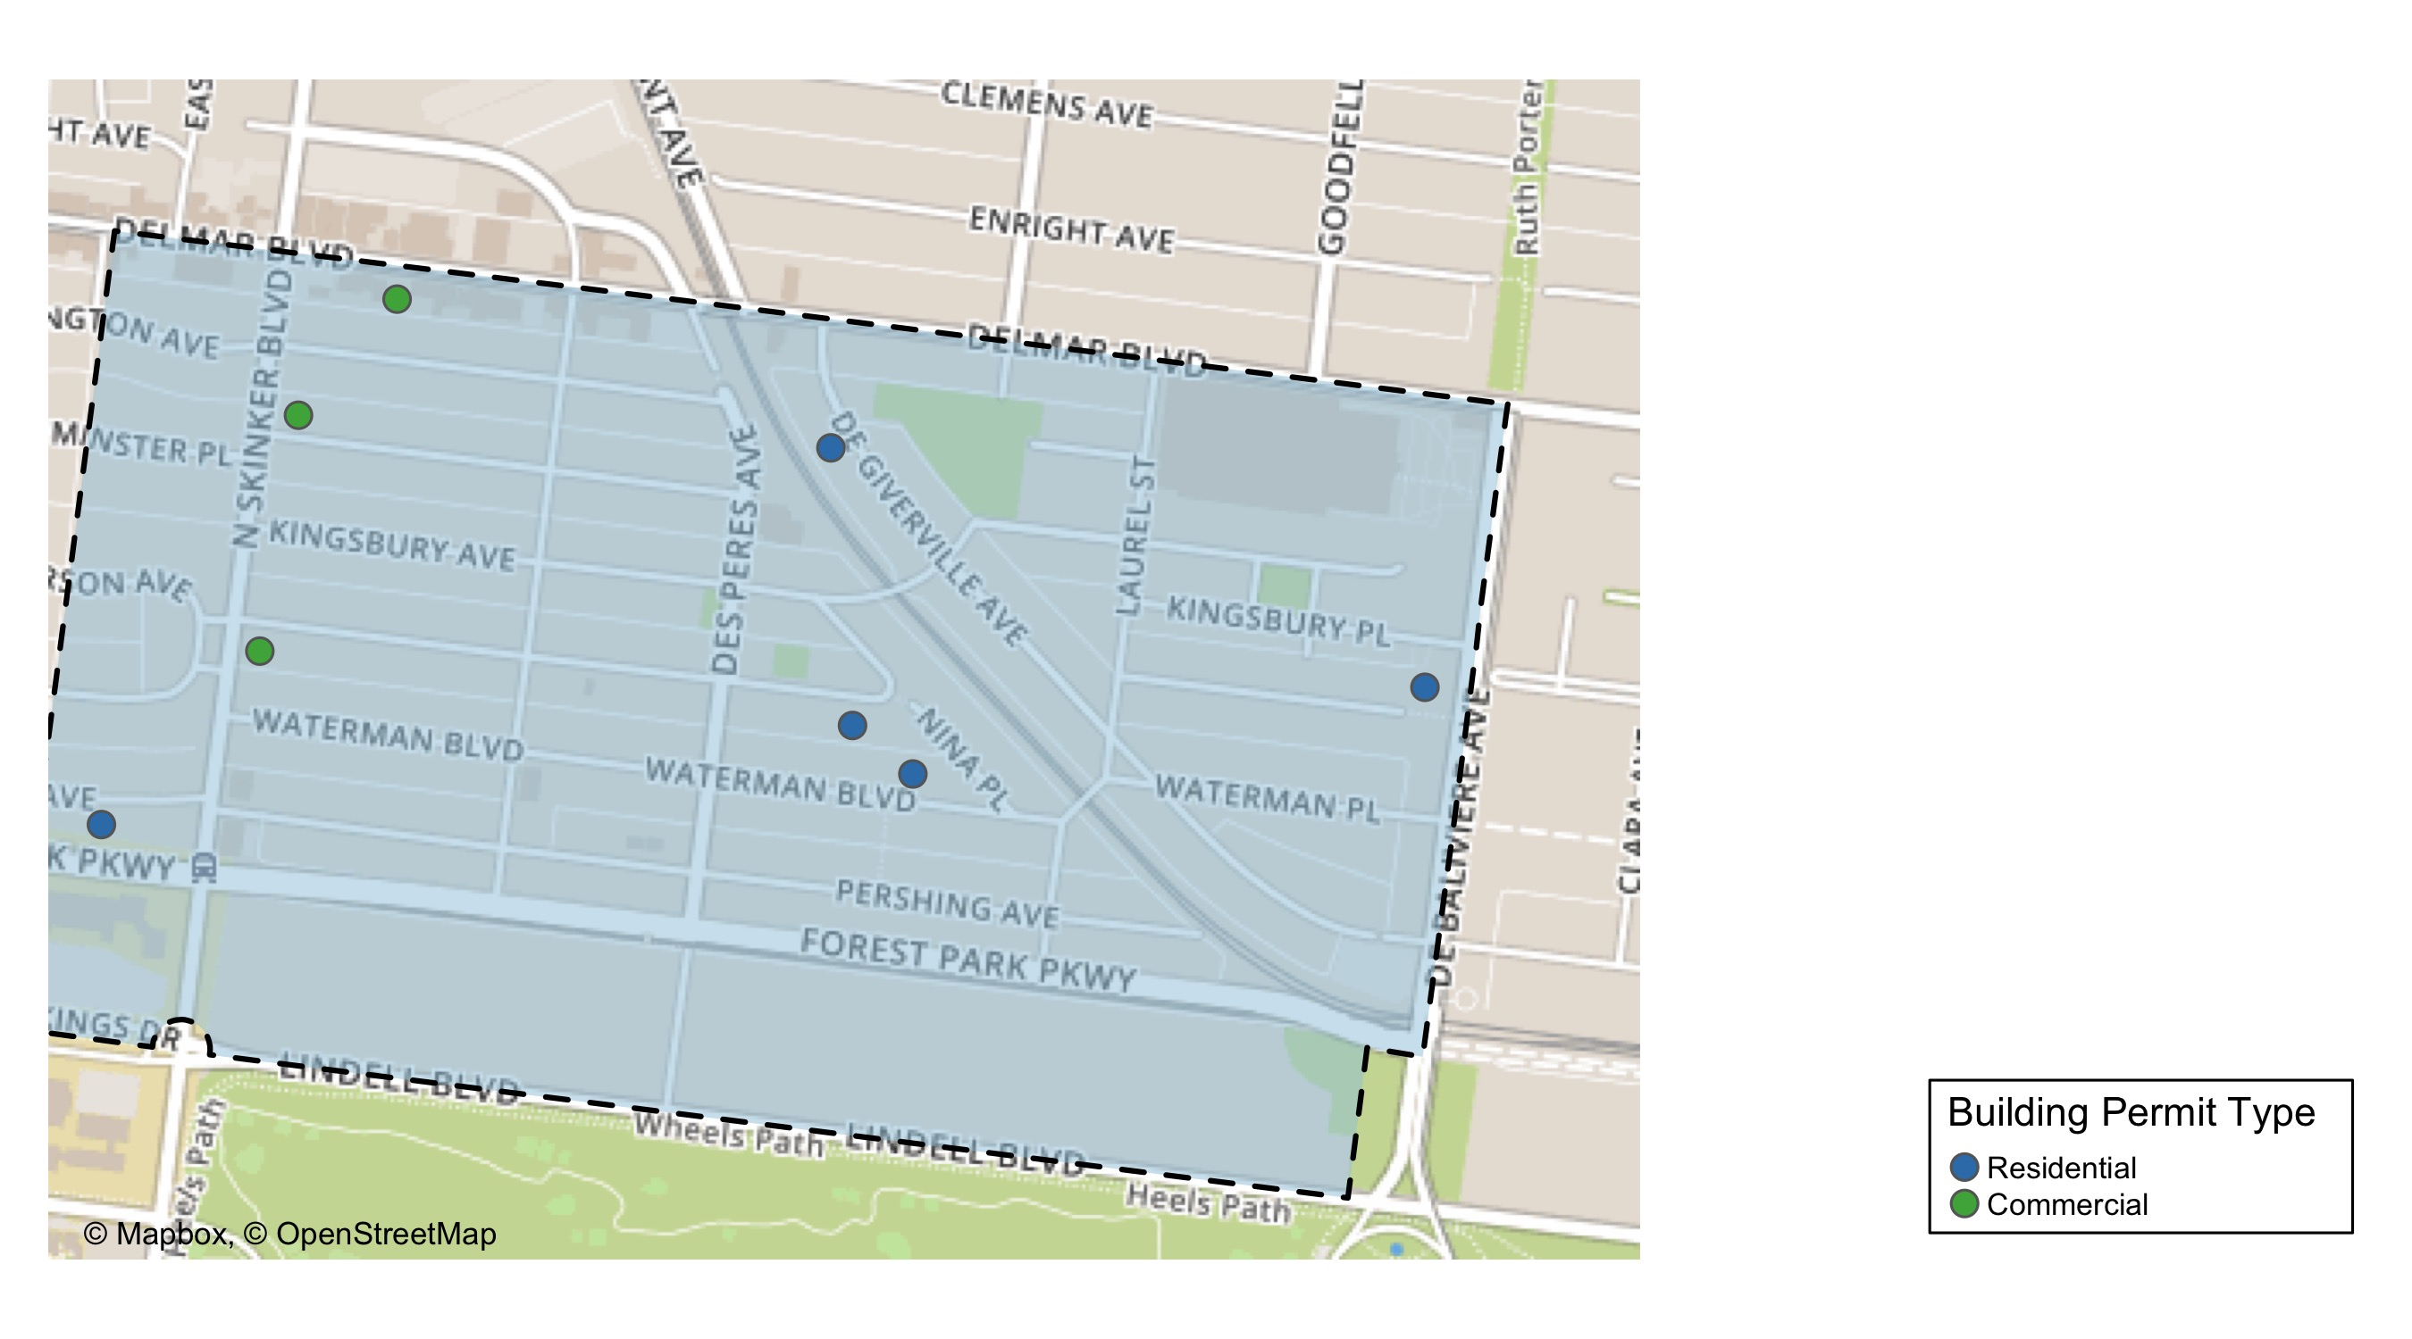
Skinker DeBaliviere

Slide 21
Neighborhood Summary
February 2022 | February 2022 | February 2022 | February 2022
Permit Use | Average Cost | # of Permits | Total Value of Permits
Commercial | $1,275,667 | 3 | $3,827,000
Industrial | $0 | 0 | $0
Residential | $23,540 | 5 | $117,700
Last 6 Months | Last 6 Months | Last 6 Months | Last 6 Months
Permit Use | Average Cost | # of Permits | Total Value of Permits
Commercial | $467,052.8 | 9 | $4,203,475
Industrial | $27,100.0 | 5 | $135,500
Residential | $214,807.9 | 32 | $6,873,853

Slide 22
Skinker DeBaliviere Individual Permit Breakdown
Neighborhood | Owner | New Use | Cost | address
Skinker DeBaliviere | CHURCH BUILDING LLC | Commercial | $3,800,000 | 6160 DELMAR BLVD
Skinker DeBaliviere | WINTER GARDEN SENIOR HOUSING LP | Residential | $16,200 | 5708 KINGSBURY PL
Skinker DeBaliviere | WASHINGTON UNIVERSITY | Commercial | $25,000 | 6188 MCPHERSON AV
Skinker DeBaliviere | POWELL, DAVID L & JOHN A POWELL | Commercial | $2,000 | 6189 WESTMINSTER PL
Skinker DeBaliviere | DUNNAVANT, HEATHER E | Residential | $2,000 | 5855 WATERMAN BLVD
Skinker DeBaliviere | MOFID, ADAM Z & NOAH R ROBINS | Residential | $12,000 | 6234 PERSHING AV
Skinker DeBaliviere | JONES, STERLING | Residential | $80,000 | 5952 DEGIVERVILLE AV
Skinker DeBaliviere | DOLAN PL LLC | Residential | $7,500 | 5920 MCPHERSON AV

Slide 23
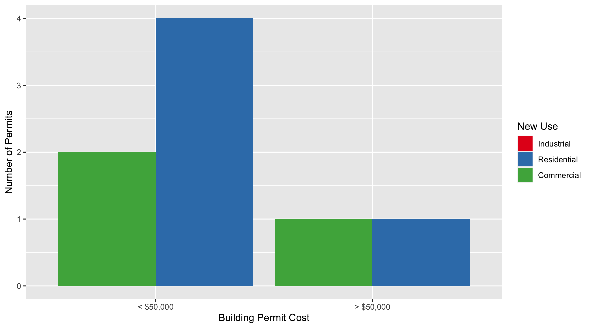
Skinker DeBaliviere Permit Cost Breakdown

Slide 24
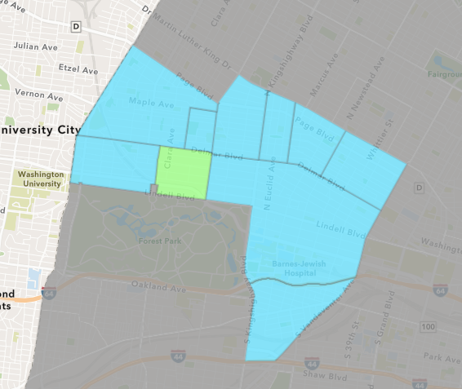
DeBaliviere Place
February 2022 Neighborhood Cost Breakdown
Mean: $4,130
Median: $4,130
Range: $3,400 - $4,860

Slide 25
DeBaliviere Place: Summary Notes
2 building permits in February 2022
-60.00% change compared to February 2021 (5 total building permits)
$4,130: Average building permit cost in February 2022
-88.10% change compared to February 2021 ($34,709)
4 total building permits in 2022
-69.23% change YTD compared to this time in 2021 (13 total building permits)
$18,137: YTD average building permit cost in 2022
-71.30% change YTD compared to this time in 2021 ($63,196)

Slide 26
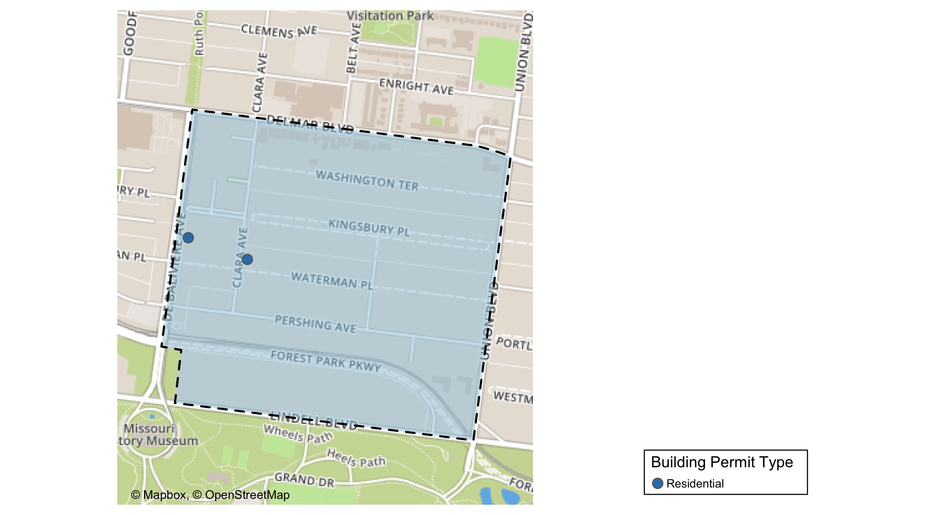
DeBaliviere Place

Slide 27
Neighborhood Summary
February 2022 | February 2022 | February 2022 | February 2022
Permit Use | Average Cost | # of Permits | Total Value of Permits
Commercial | $0 | 0 | $0
Industrial | $0 | 0 | $0
Residential | $4,130 | 2 | $8,260
Last 6 Months | Last 6 Months | Last 6 Months | Last 6 Months
Permit Use | Average Cost | # of Permits | Total Value of Permits
Commercial | $26,250.00 | 2 | $52,500
Industrial | $30,000.00 | 1 | $30,000
Residential | $56,910.33 | 21 | $1,195,117

Slide 28
DeBaliviere Place Individual Permit Breakdown
Neighborhood | Owner | New Use | Cost | address
DeBaliviere Place | GROSSMAN, DAVID & PENNY ROBINSON | Residential | $3,400 | 5696 KINGSBURY AV
DeBaliviere Place | HAMPSHIRE SQUARE CONDO | Residential | $4,860 | 406 CLARA AV

Slide 29
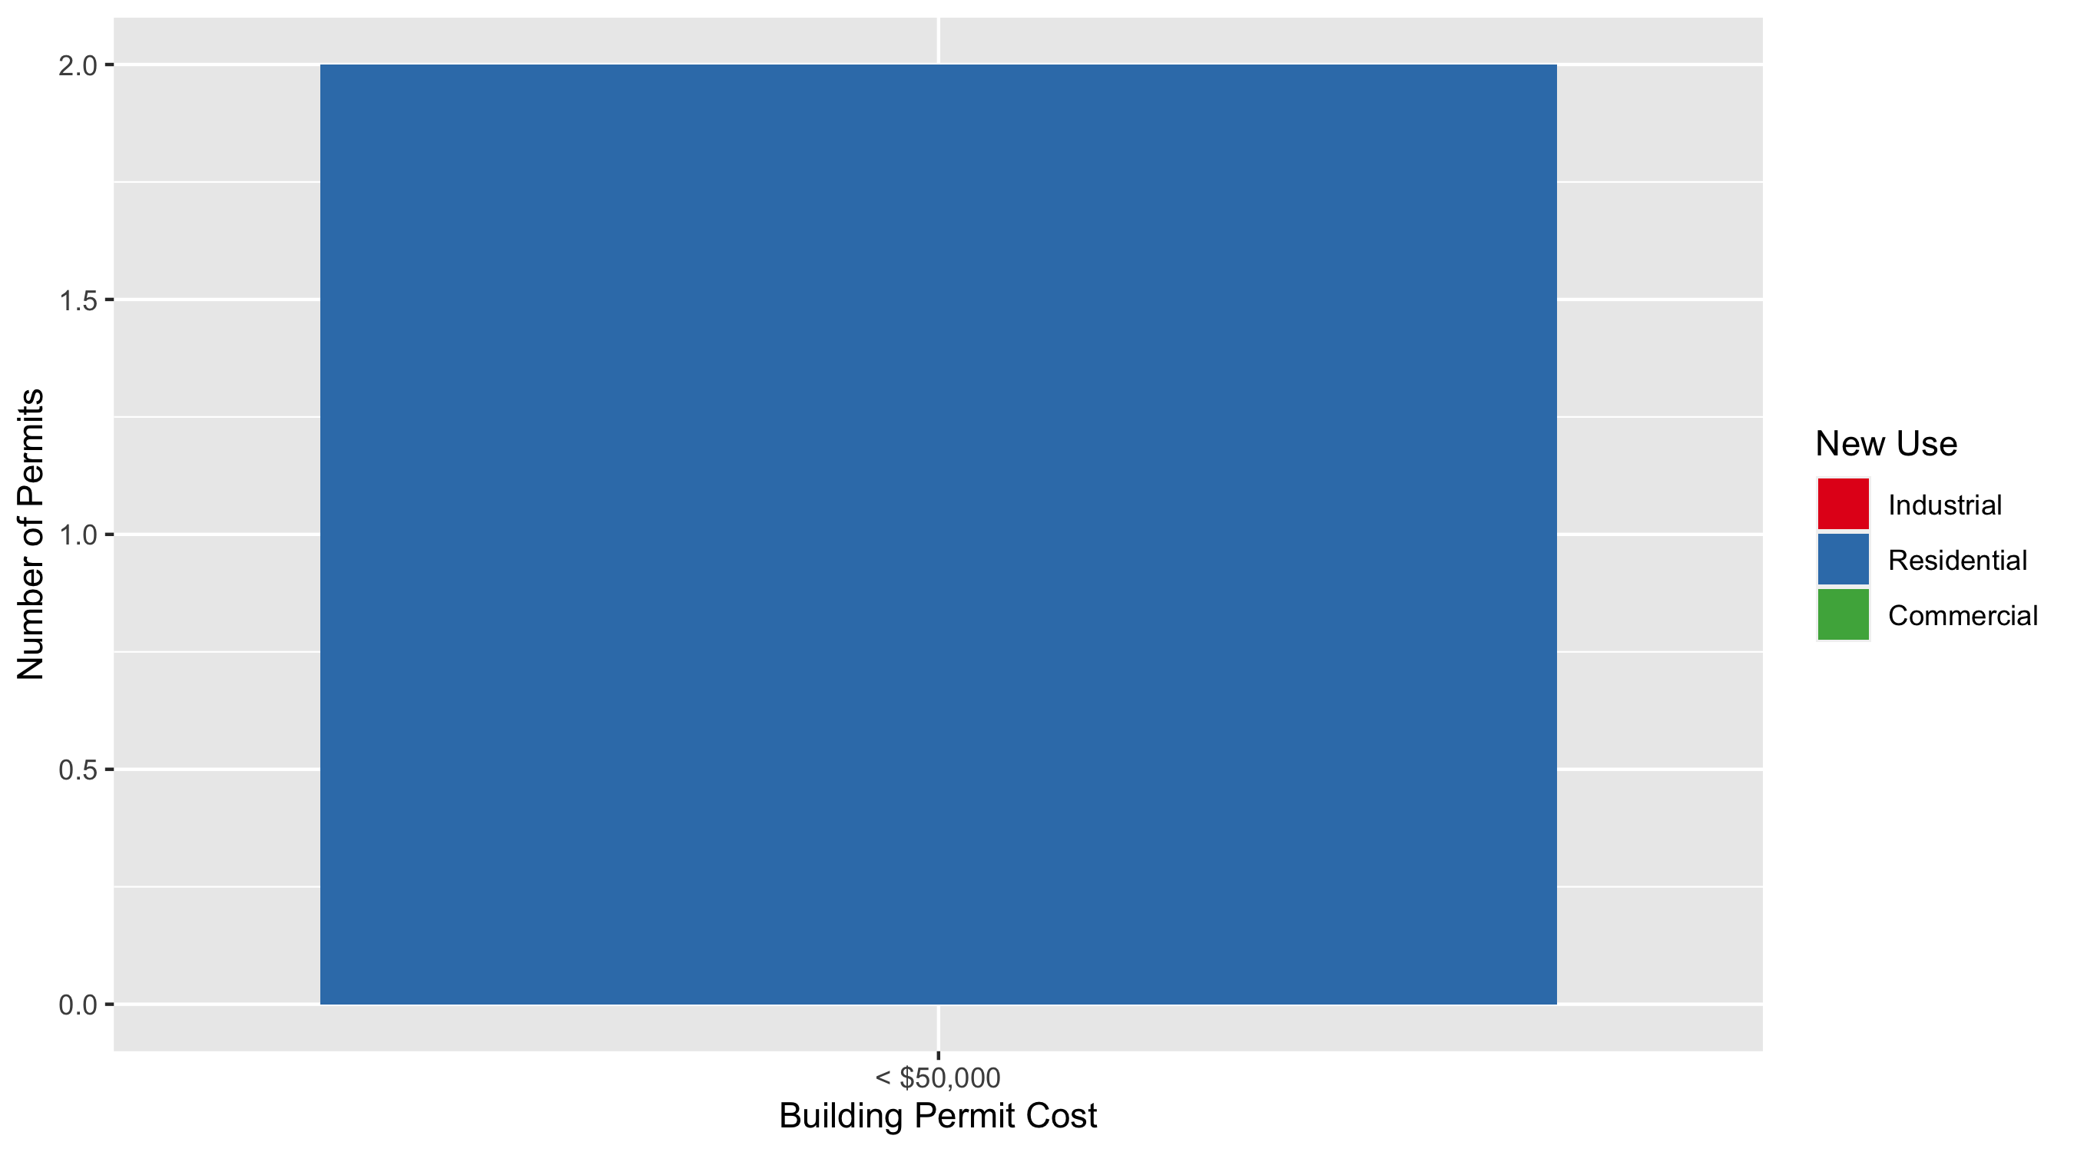
DeBaliviere Place Permit Cost Breakdown

Slide 30
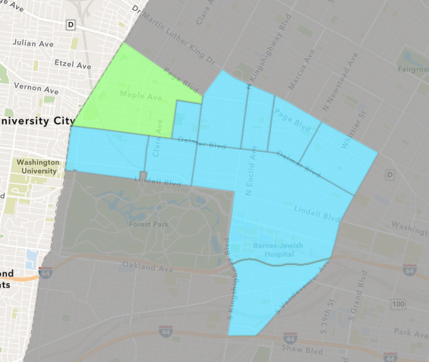
West End
February 2022 Neighborhood Cost Breakdown
Mean: $223,016
Median: $100,800
Range: $1,200 - $984,144

Slide 31
West End: Summary Notes
33 building permits in February 2022
371.43% change compared to February 2021 (7 total building permits)
$223,016: Average building permit cost in February 2022
612.86% change compared to February 2021 ($31,285)
40 total building permits in 2022
122.22% change YTD compared to this time in 2021 (18 total building permits)
$186,610: YTD average building permit cost in 2022
74.79% change YTD compared to this time in 2021 ($106,762)

Slide 32
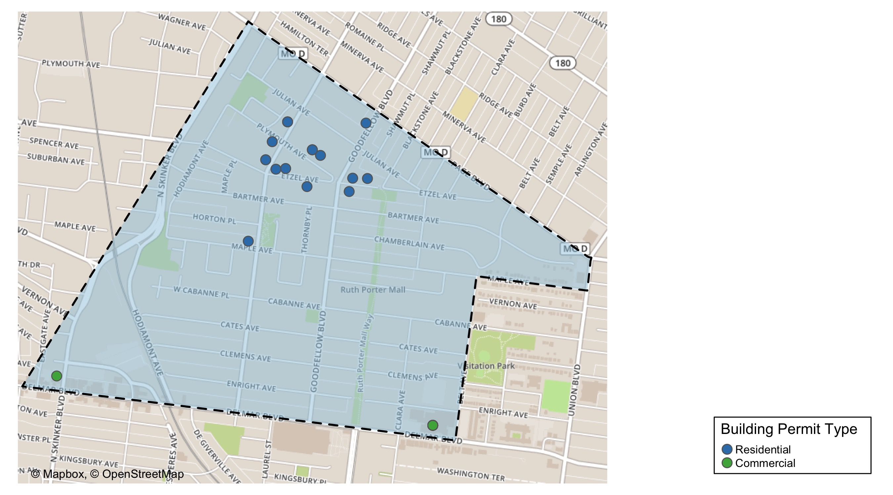
West End

Slide 33
Neighborhood Summary
February 2022 | February 2022 | February 2022 | February 2022
Permit Use | Average Cost | # of Permits | Total Value of Permits
Commercial | $87,624.73 | 15 | $1,314,371
Industrial | $0.00 | 0 | $0
Residential | $335,841.56 | 18 | $6,045,148
Last 6 Months | Last 6 Months | Last 6 Months | Last 6 Months
Permit Use | Average Cost | # of Permits | Total Value of Permits
Commercial | $54,257.88 | 50 | $2,712,894
Industrial | $14,730.50 | 2 | $29,461
Residential | $123,875.62 | 55 | $6,813,159

Slide 34
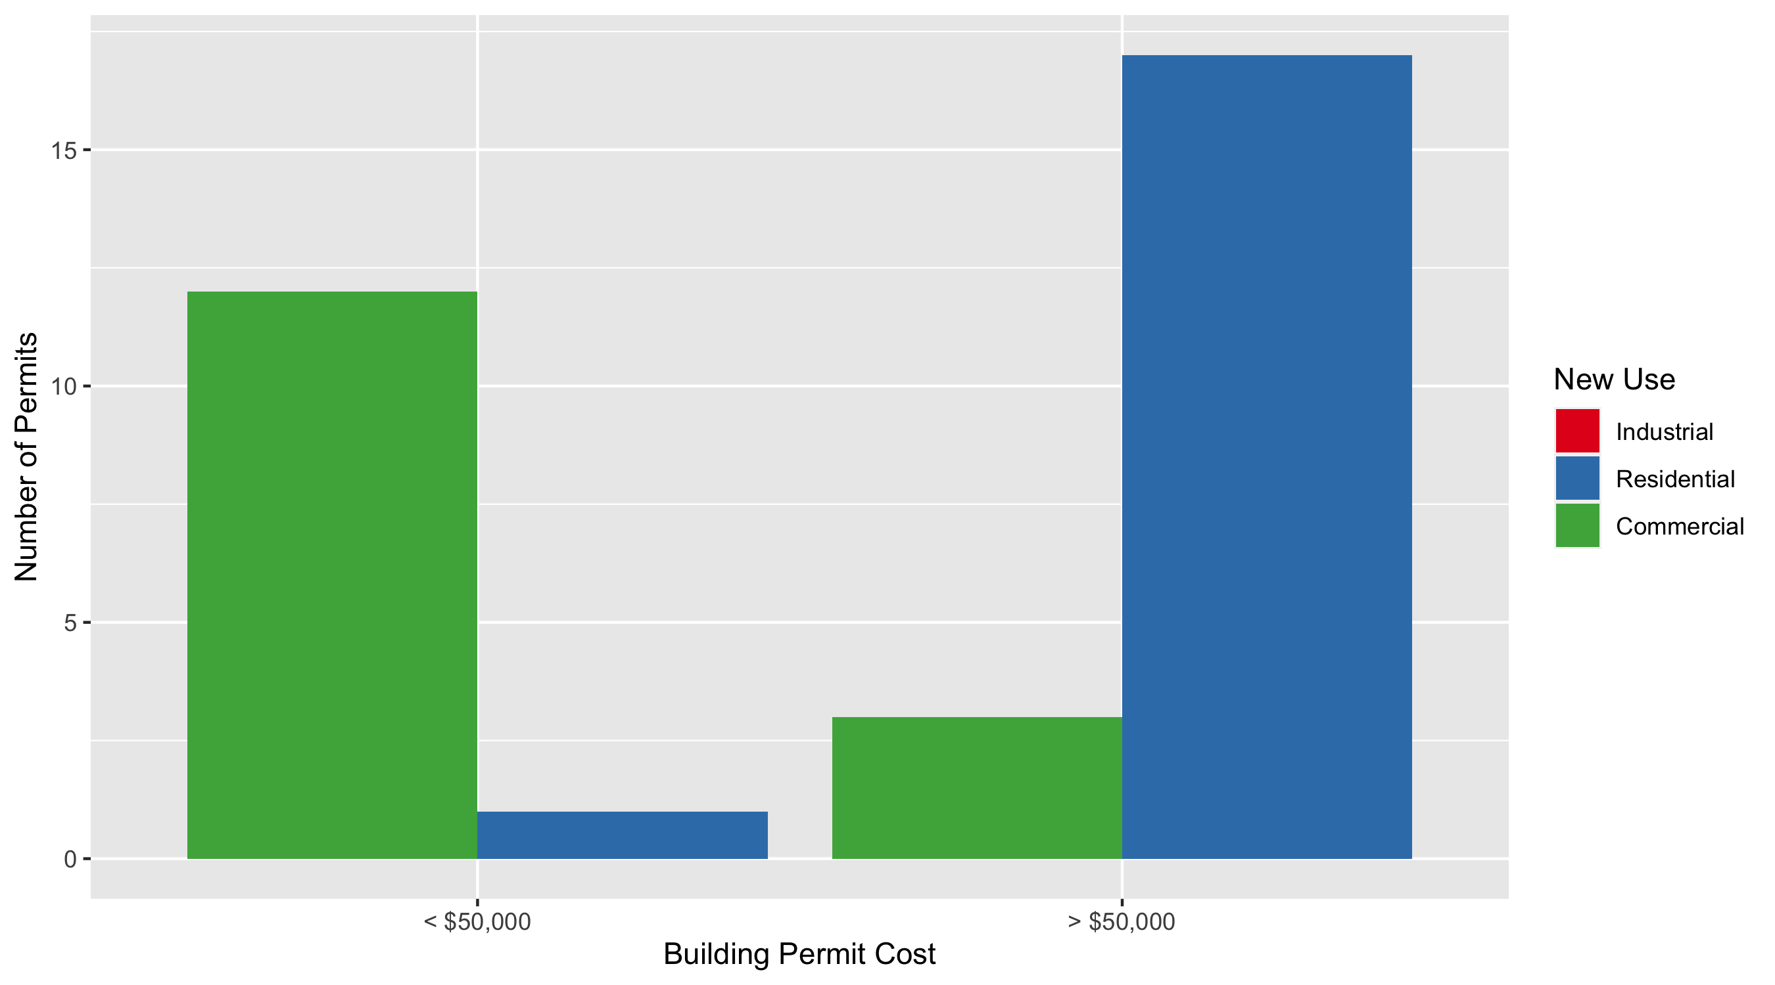
West End Permit Cost Breakdown

Slide 35
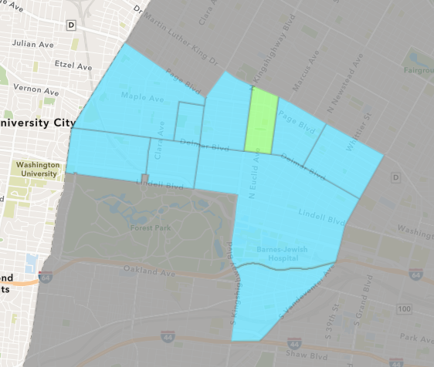
Fountain Park
February 2022 Neighborhood Cost Breakdown
Mean: $9,000
Median: $9,000
Range: $9,000 - $9,000

Slide 36
Fountain Park: Summary Notes
2 building permits in February 2022
0.00% change compared to February 2021 (2 total building permits)
$9,000: Average building permit cost in February 2022
-99.37% change compared to February 2021 ($1,418,674)
2 total building permits in 2022
0.00% change YTD compared to this time in 2021 (2 total building permits)
$9,000: YTD average building permit cost in 2022
-99.37% change YTD compared to this time in 2021 ($1,418,674)

Slide 37
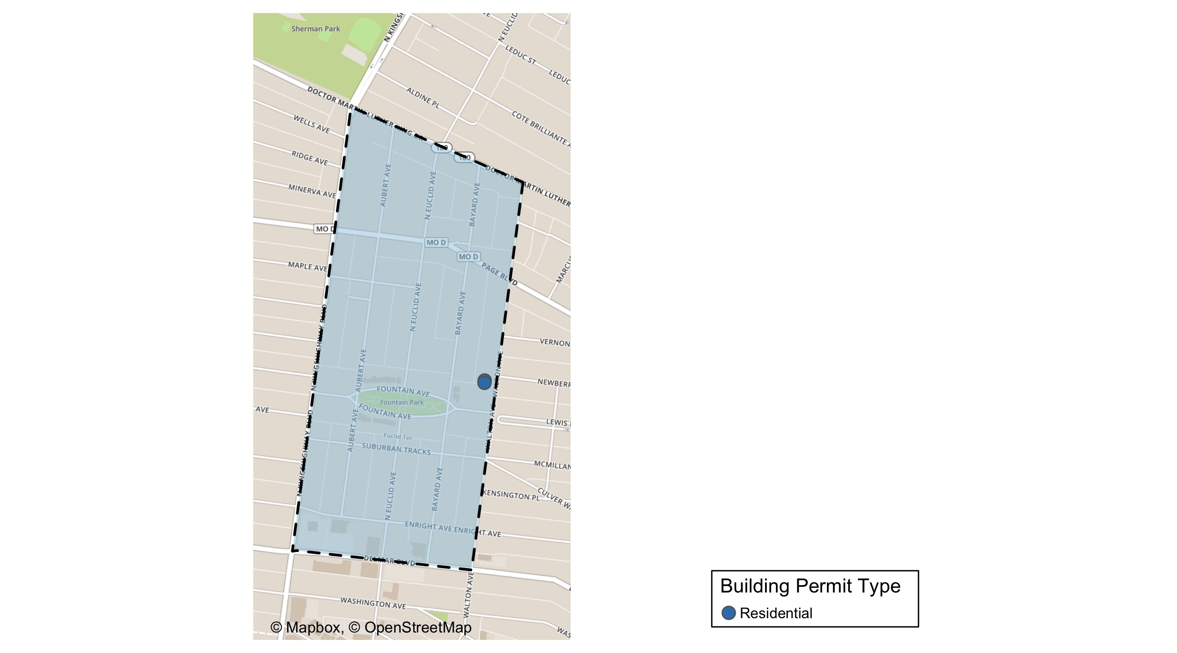
Fountain Park

Slide 38
Neighborhood Summary
February 2022 | February 2022 | February 2022 | February 2022
Permit Use | Average Cost | # of Permits | Total Value of Permits
Commercial | $0 | 0 | $0
Industrial | $0 | 0 | $0
Residential | $9,000 | 2 | $18,000
Last 6 Months | Last 6 Months | Last 6 Months | Last 6 Months
Permit Use | Average Cost | # of Permits | Total Value of Permits
Commercial | $28,333.33 | 3 | $85,000
Industrial | $0.00 | 0 | $0
Residential | $37,448.33 | 6 | $224,690

Slide 39
Fountain Park Individual Permit Breakdown
Neighborhood | Owner | New Use | Cost | address
Fountain Park | WILLIAMS, DONALD | Residential | $9,000 | 1125 WALTON AV
Fountain Park | WILLIAMS, DONALD | Residential | $9,000 | 1127 WALTON AV

Slide 40
Fountain Park Permit Cost Breakdown

Slide 41
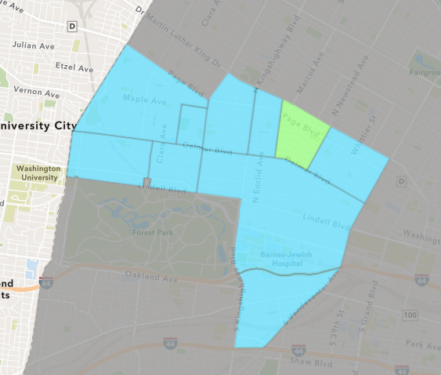
Lewis Place
February 2022 Neighborhood Cost Breakdown
Mean: $4,500
Median: $4,500
Range: $4,500 - $4,500

Slide 42
Lewis Place: Summary Notes
1 building permits in February 2022
0.00% change compared to February 2021 (1 total building permits)
$4,500: Average building permit cost in February 2022
-90.00% change compared to February 2021 ($45,000)
2 total building permits in 2022
-33.33% change YTD compared to this time in 2021 (3 total building permits)
$6,000: YTD average building permit cost in 2022
-69.45% change YTD compared to this time in 2021 ($19,641)

Slide 43
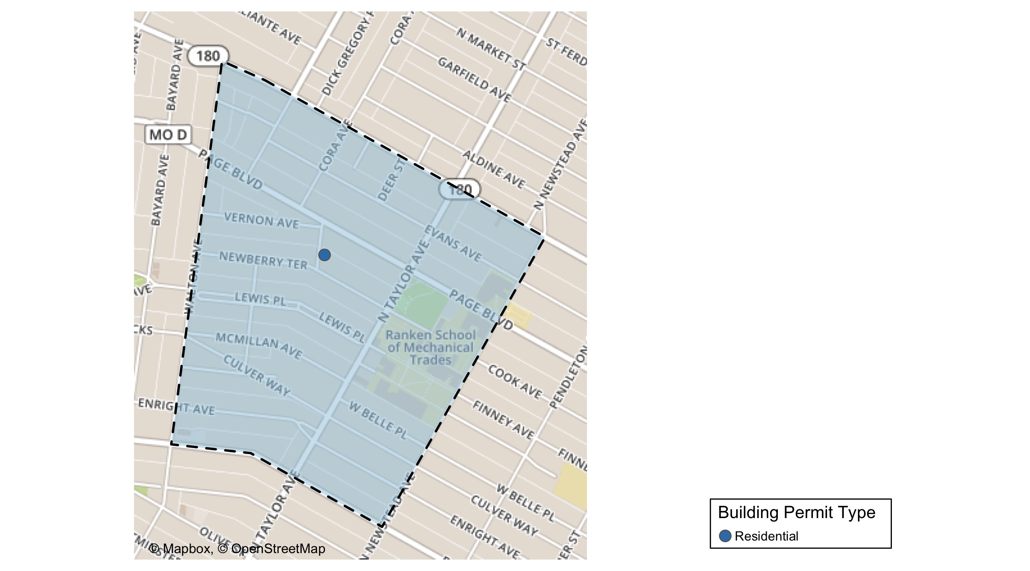
Lewis Place

Slide 44
Neighborhood Summary
February 2022 | February 2022 | February 2022 | February 2022
Permit Use | Average Cost | # of Permits | Total Value of Permits
Commercial | $0 | 0 | $0
Industrial | $0 | 0 | $0
Residential | $4,500 | 1 | $4,500
Last 6 Months | Last 6 Months | Last 6 Months | Last 6 Months
Permit Use | Average Cost | # of Permits | Total Value of Permits
Commercial | $279,084.0 | 4 | $1,116,336
Industrial | $2,000.0 | 2 | $4,000
Residential | $32,112.5 | 8 | $256,900

Slide 45
Lewis Place Individual Permit Breakdown
Neighborhood | Owner | New Use | Cost | address
Lewis Place | HARRIS, SANDRA | Residential | $4,500 | 1212 REV GEORGE H PRUITT PL

Slide 46
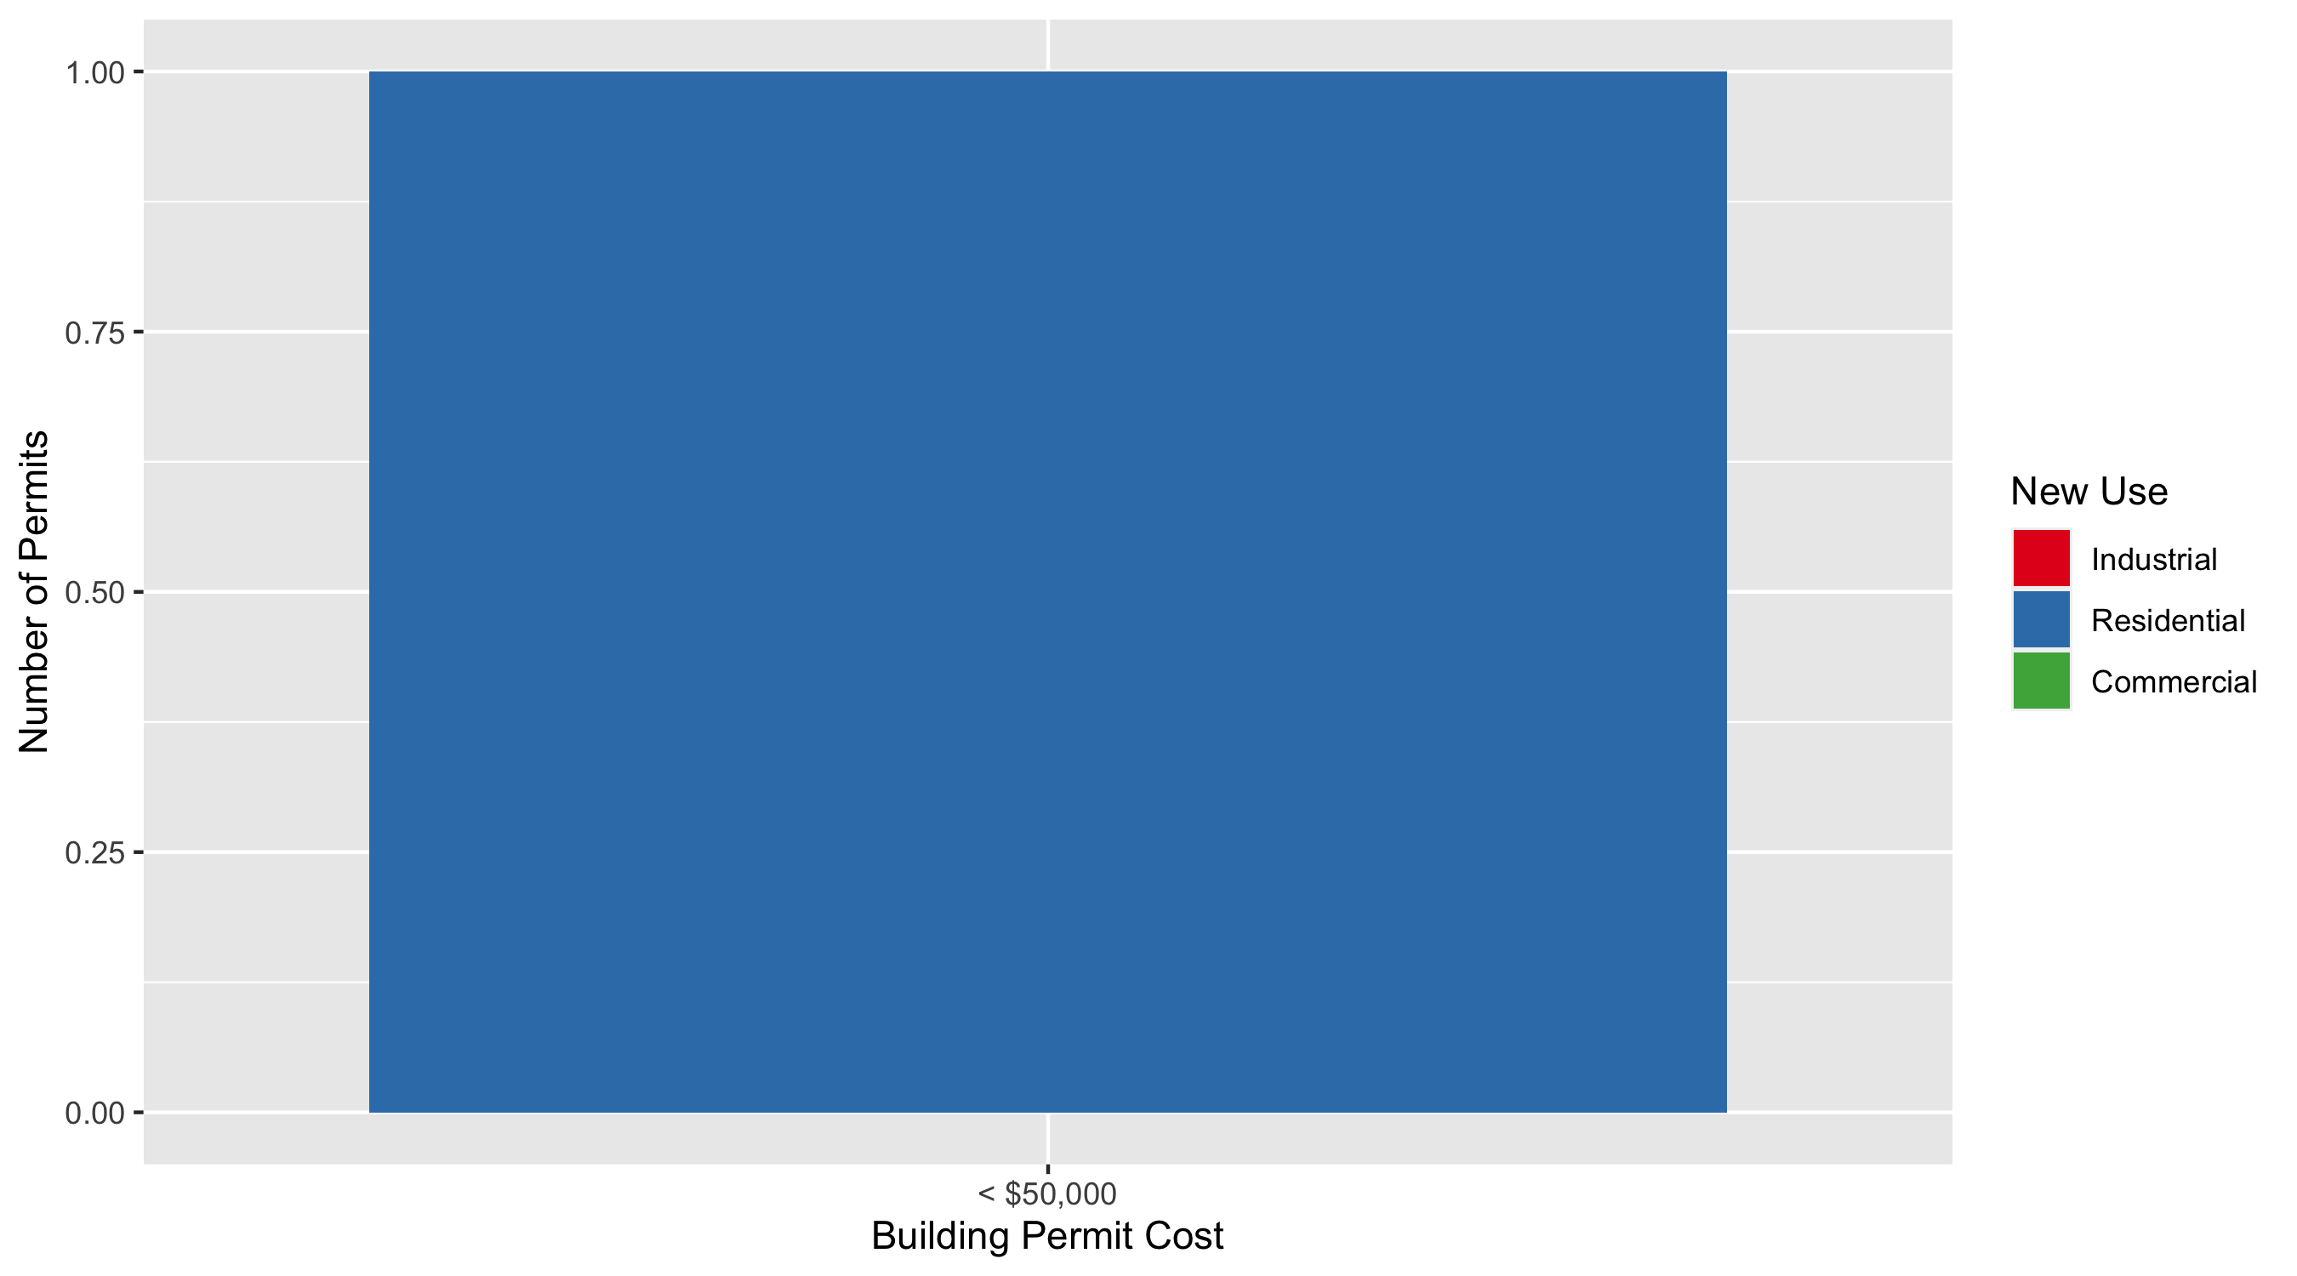
Lewis Place Permit Cost Breakdown

Slide 47
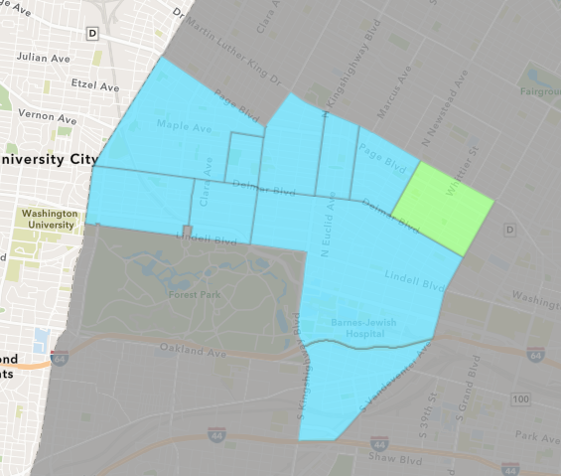
Vandeventer
February 2022 Neighborhood Cost Breakdown
Mean: $57,167
Median: $3,500
Range: $3,000 - $165,000

Slide 48
Vandeventer: Summary Notes
3 building permits in February 2022
Infinite change compared to February 2021 (0 total building permits)
$57,167: Average building permit cost in February 2022
Infinite change compared to February 2021 ($0)
4 total building permits in 2022
Infinite change YTD compared to this time in 2021 (0 total building permits)
$73,875: YTD average building permit cost in 2022
Infinite change YTD compared to this time in 2021 ($0)

Slide 49
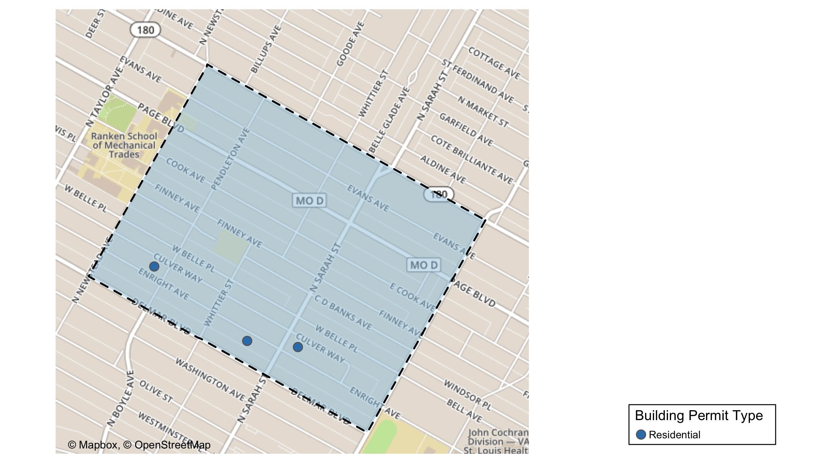
Vandeventer

Slide 50
Neighborhood Summary
February 2022 | February 2022 | February 2022 | February 2022
Permit Use | Average Cost | # of Permits | Total Value of Permits
Commercial | $0.00 | 0 | $0
Industrial | $0.00 | 0 | $0
Residential | $57,166.67 | 3 | $171,500
Last 6 Months | Last 6 Months | Last 6 Months | Last 6 Months
Permit Use | Average Cost | # of Permits | Total Value of Permits
Commercial | $0.0 | 0 | $0
Industrial | $4,750.0 | 2 | $9,500
Residential | $112,174.9 | 14 | $1,570,448

Slide 51
Vandeventer Individual Permit Breakdown
Neighborhood | Owner | New Use | Cost | address
Vandeventer | PATTERSON, SHARON E | Residential | $165,000 | 4140 ENRIGHT AV
Vandeventer | EBEGBODI, SAMUEL | Residential | $3,000 | 4053 ENRIGHT AV
Vandeventer | WOOD FAMILY HOMES LLC | Residential | $3,500 | 4317 ENRIGHT AV

Slide 52
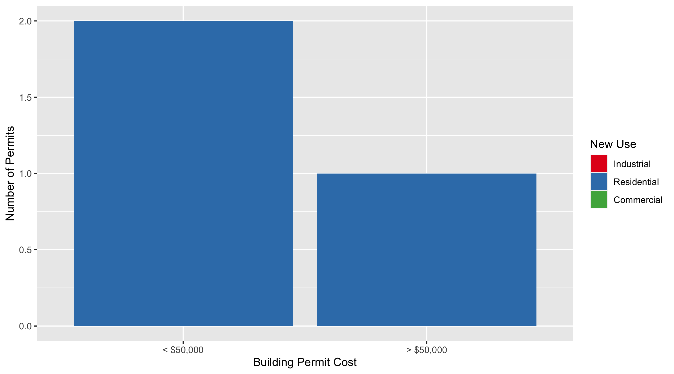
Vandeventer Permit Cost Breakdown

Slide 53
Additional Notes
Data retreived from https://www.stlouis-mo.gov/data/
Building permits with a cost of $0 were dropped
Building permits that were cancelled were dropped
Infinite change indicates 0 permits in the current or previous time period/comparison month so there was a overall increase or decrease

